Slide 1
Persian Polymath: Ibn Sīna and the Development of Islamic Philosophy and Science
Katherine Jacka, Department of Arabic Language and Cultures, University of Sydney

Slide 2
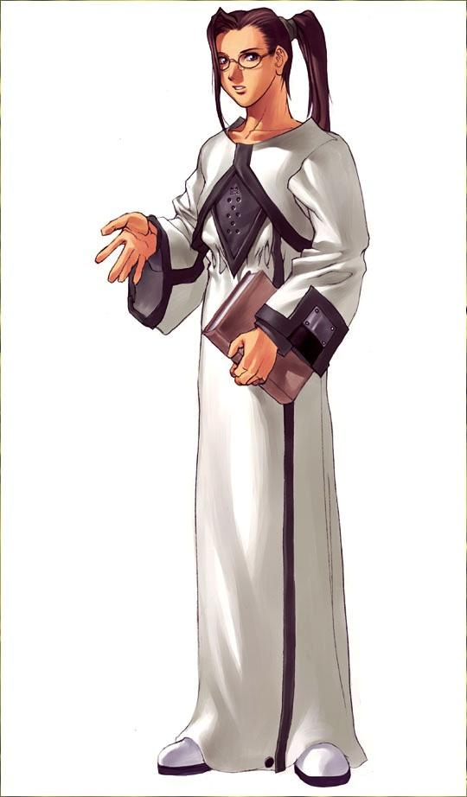
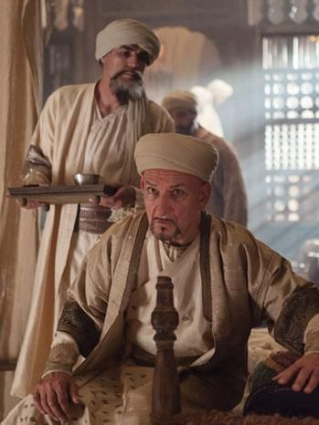
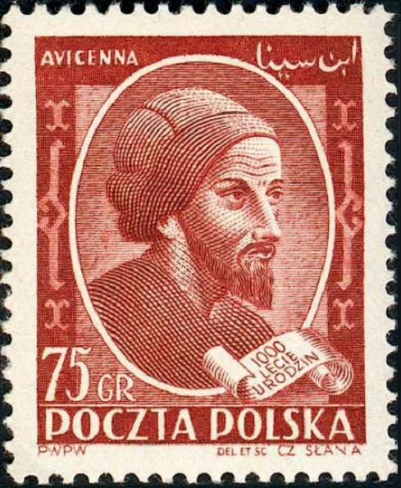

Slide 3
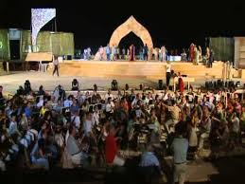
‘Avicenna’
Doha, 2003

Slide 4
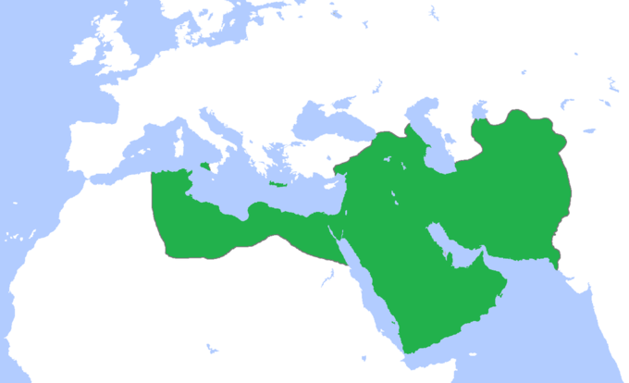
Abbasid caliphate
c.850 CE

Slide 5
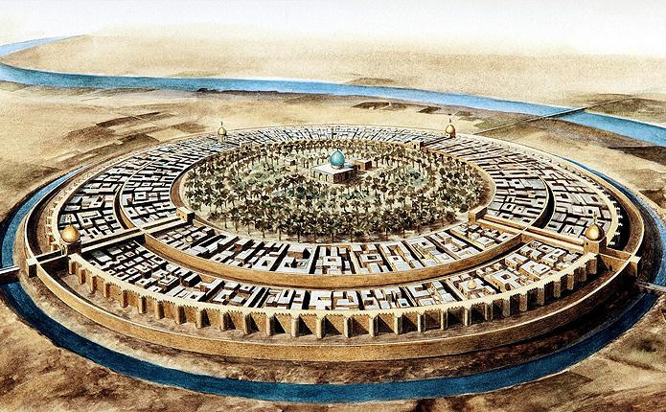
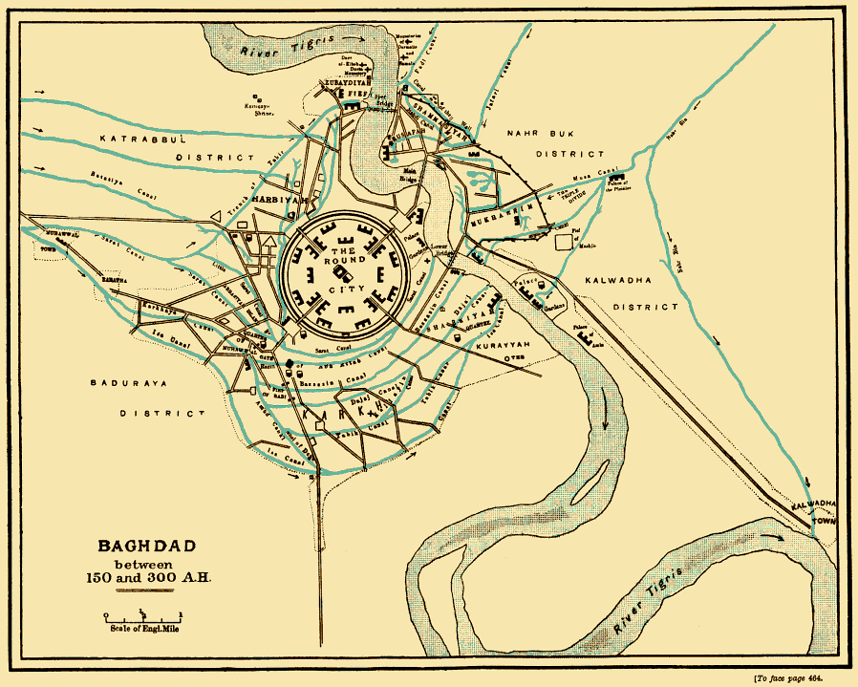
Madinat-as-Salām
(City of Peace) - Baghdad

Slide 6
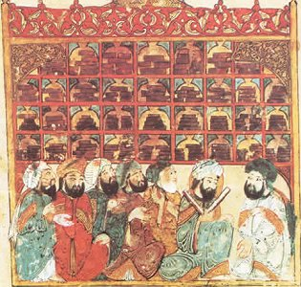
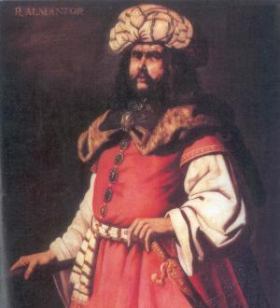
Scholars in Baghdad , Maqamat of al-Hariri, (1237)
Al-Manṣūr, Francisco de Zurbarán, (17th century)

Slide 7
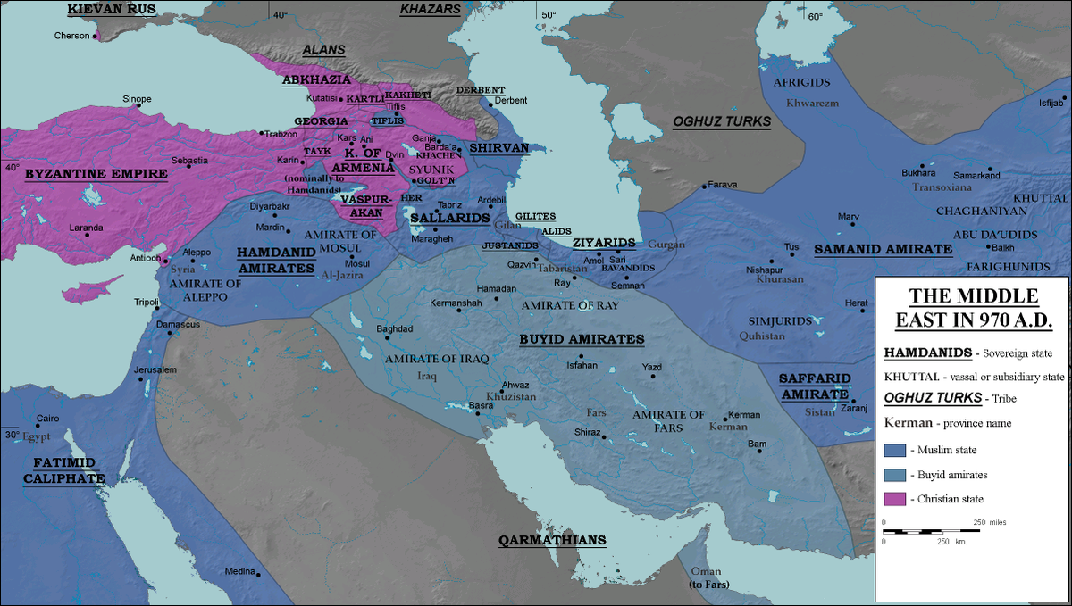

Slide 8
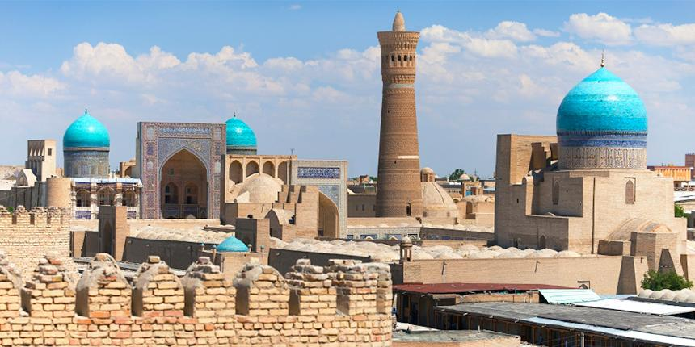
Bukhara

Slide 9
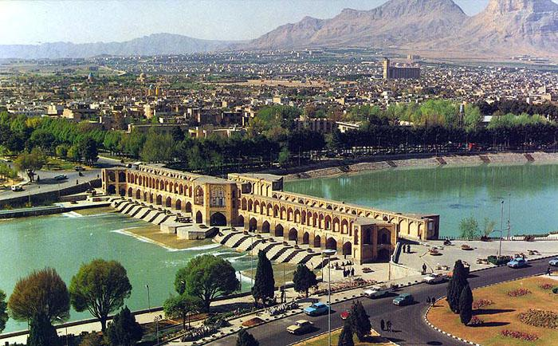
Isfahan

Slide 10
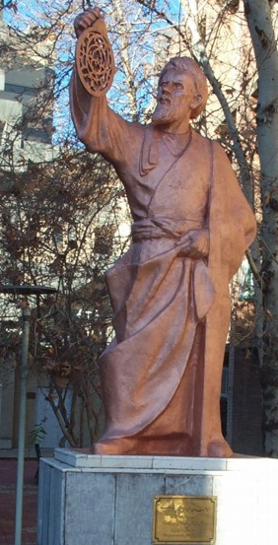
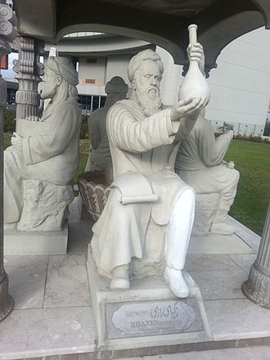
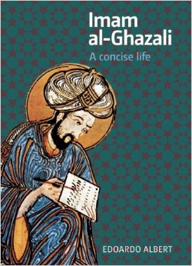
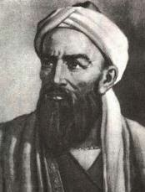
Al-Khwarizmi
Ar-Rāzi
Al-Birūni
Al-Ghazāli

Slide 11
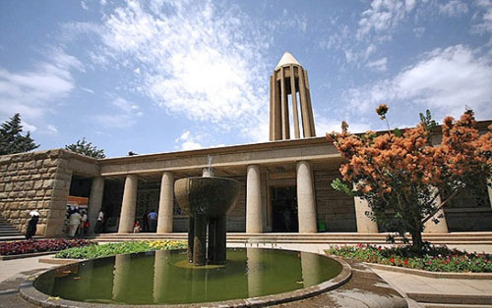
Ibn Sīna’s Mausoleum
Hamadan, Iran

Slide 12
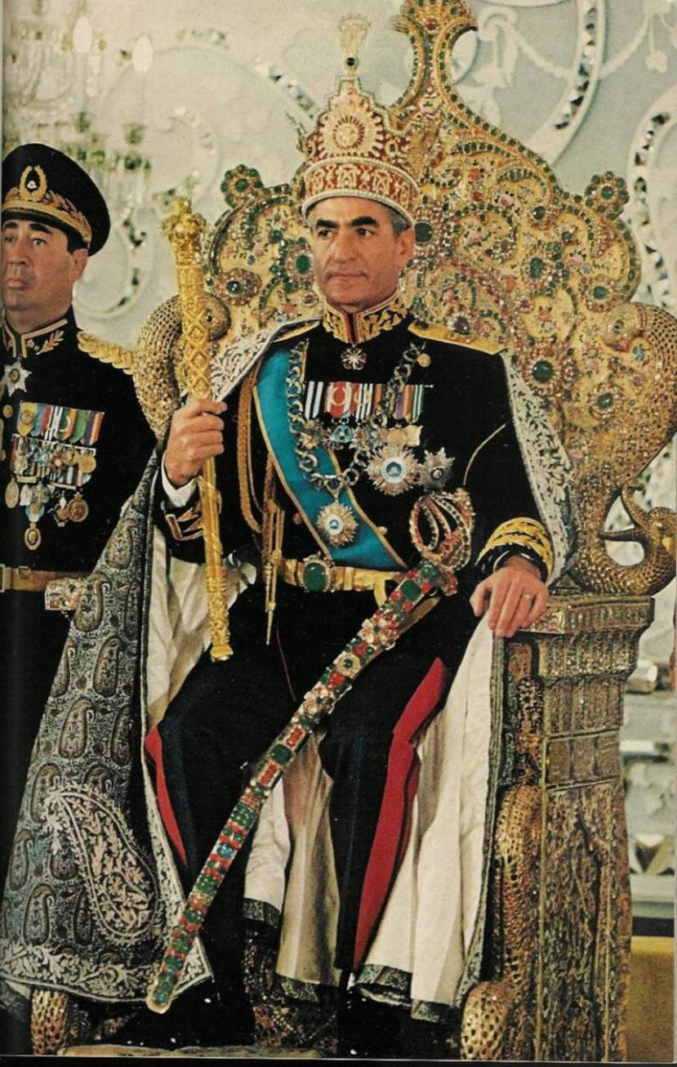
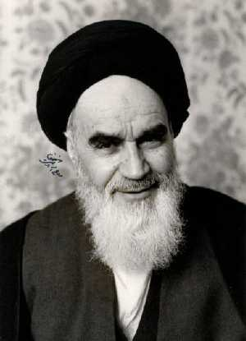

Slide 13
Further Reading:
Peter Adamson and Richard C. Taylor (eds.), The Cambridge Companion to Arabic Philosophy, Cambridge University Press, 2005
Soheil M. Afnan, Avicenna, His Life and Works, Routledge, 1958
P. Bearman et al (eds.), The Encyclopaedia of Islam, 2nd ed., Brill
Amira K. Bennison, The Great Caliphs: The Golden Age of the ‘Abbasid Empire. I.B.Tauris , 2011
Dimitri Gutas, Avicenna and the Aristotelian Tradition, Brill, 2013
Dimitri Gutas, Greek Thought, Arabic Culture: The Graeco-Arabic Translation Movement in Baghdad and Early ‘Abbasaid Society (2nd-4th/5th-10th c.), Routledge, 1998
History of Philosophy without any gaps (Podcast), King’s College London, https://www.historyofphilosophy.net/

